Slide 1
Introduction to the focused and diffuse mode
Barbara Oakley, PhD

Slide 2

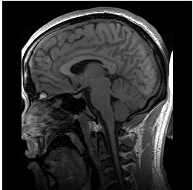
http://en.wikipedia.org/wiki/File:Parasagittal_MRI_of_human_head_in_patient_with_benign_familial_macrocephaly_prior_to_brain_injury_(ANIMATED).gif

Slide 3

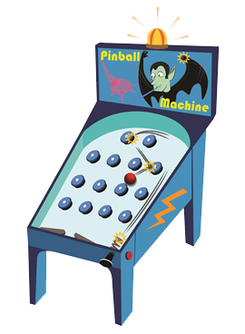
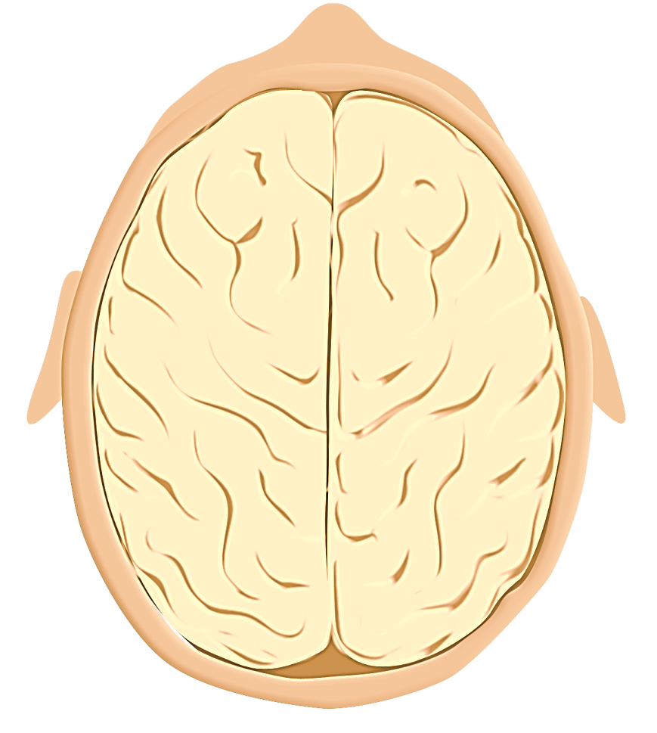

Slide 4
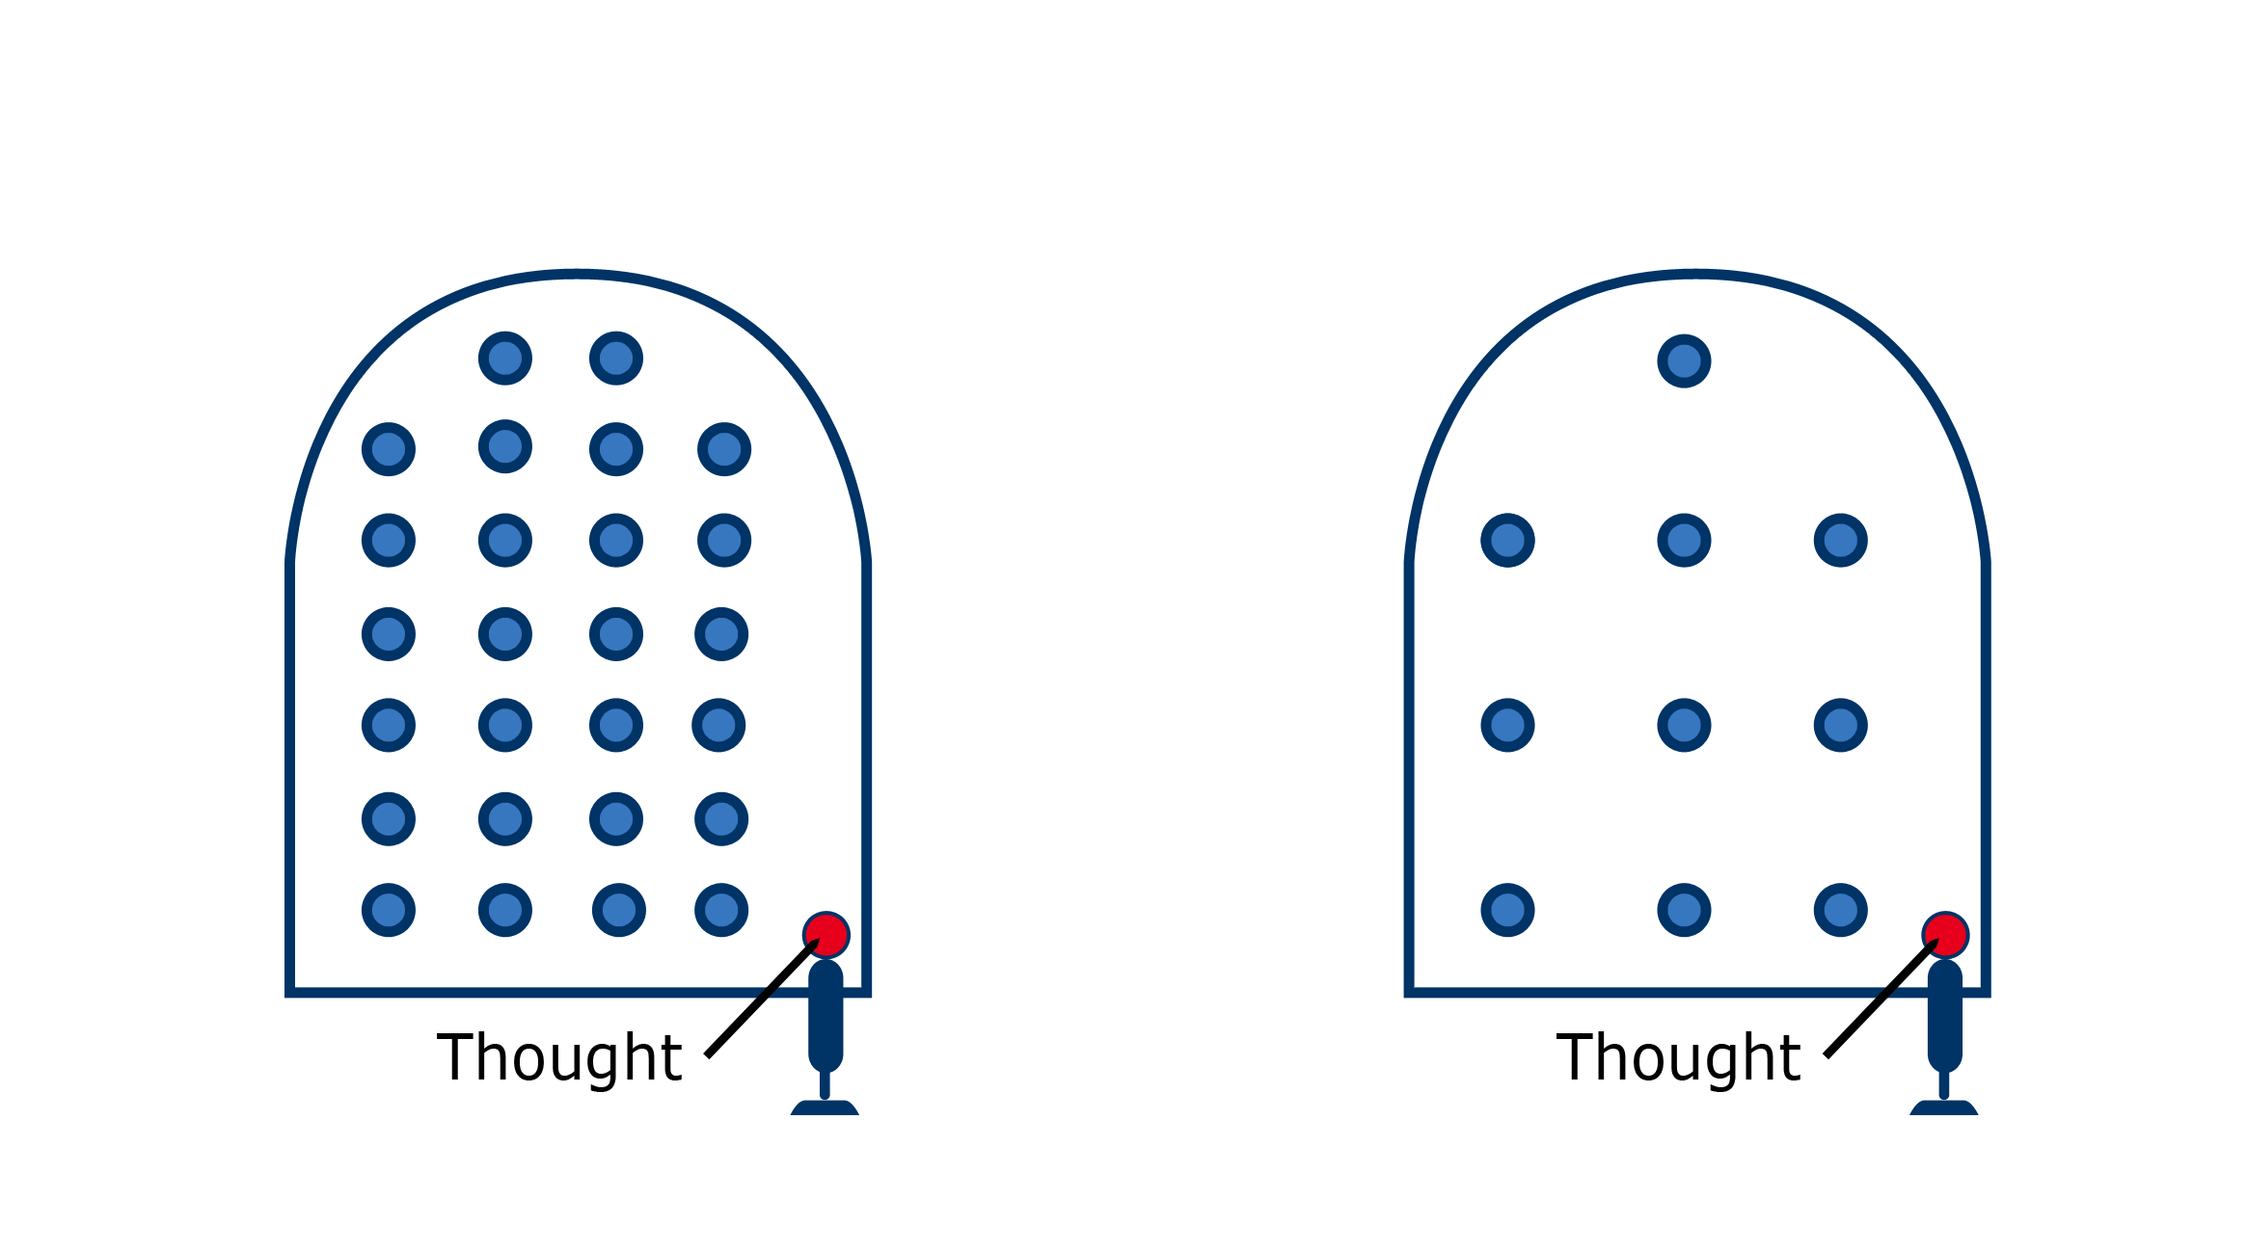
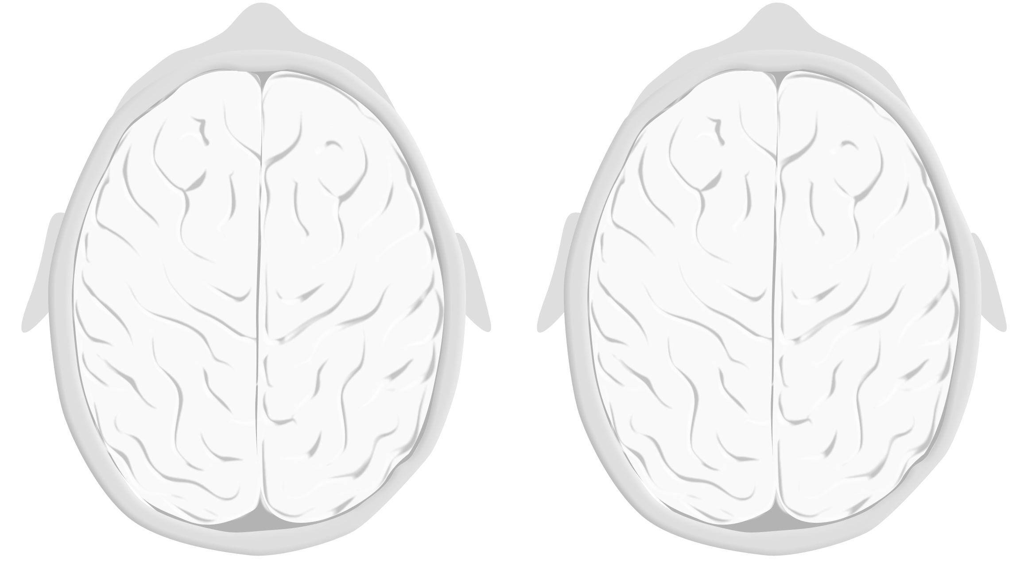
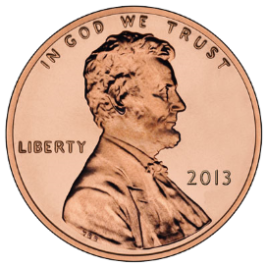
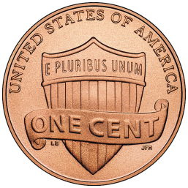
Diffuse Mode
Focused Mode

Slide 5
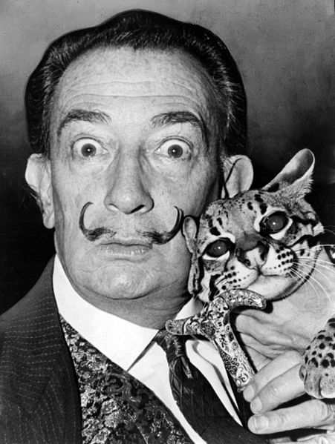
Salvador Dalí

Slide 6
Image Credits
Brain from the top, image © Kevin Mendez, 2014.
Pinball machine, image © Kevin Mendez, 2014.
Focused and diffuse thinking, image © Kevin Mendez, 2014.
Zombie ©Kevin Mendez, 2014.
Salvador Dalí with ocelot and cane, 1965; http://en.wikipedia.org/wiki/ File:Salvador_Dali_NYWTS.jpg From the Library of Congress. New York World- Telegram & Sun collection. http://hdl.loc.gov/loc.pnp/cph.3c14985; Author: Roger Higgins, World Telegram staff photographer; no copyright restriction known. Staff photographer reproduction rights transferred to Library of Congress through Instrument of Gift.
Relevant Readings
Andrews-Hanna, J. R. "The Brain's Default Network and Its Adaptive Role in Internal Mentation." Neuroscientist 18, no. 3 (Jun 2012): 251-70.
Immordino-Yang, M. H., J. A. Christodoulou, and V. Singh. "Rest Is Not Idleness: Implications of the Brain's Default Mode for Human Development and Education." Perspectives on Psychological Science 7, no. 4 (2012): 352-64.
Moussa MN, Steen MR, Laurienti PJ, Hayasaka S (2012) Consistency of Network Modules in Resting-State fMRI Connectome Data. PLoS ONE 7(8): e44428. doi:10.1371/journal.pone.0044428.
Raichle, Marcus E, and Abraham Z Snyder. "A Default Mode of Brain Function: A Brief History of an Evolving Idea." NeuroImage 37, no. 4 (2007): 1083-90.

